Slide 1
Lecture
Cost-Volume-Profit Analysis
8
L.O. 18-1: Cost behavior
L.O. 18-2: Mixed costs analysis
L.O. 18-3: Cost-volume-profit (CVP) analysis
L.O. 18-4: Break-even analysis
L.O. 18-5: Target net income & margin of safety
L.O. 19-2: Sales mix and break-even sales
L.O. 19-3: Sales mix with limited resources
L.O. 19-4: Operating leverage and profitability

Slide 2
Learning Objective 18-1
Cost Behavior

Slide 3
Outline
Cost behavior analysis
Variable costs
Fixed costs
Relevant range
Mixed costs

Slide 4
Cost Behavior Analysis
Cost Behavior Analysis is the study of how specific costs respond to changes in the level of business activity.
Activity levels may be expressed in terms of:
Sales dollars (in a retail company)
Miles driven (in a trucking company)
Room occupancy (in a hotel)
Changes in the level or volume of activity should be correlated with changes in costs.
Activity level selected is called activity or volume index.
Allows costs to be classified as variable, fixed, or mixed.

Slide 5
Variable Costs
Costs that vary in total directly and proportionately with changes in the activity level.
Example: If the activity level increases 10 percent, total variable costs increase 10 percent.
Example: If the activity level decreases by 25 percent, total variable costs decrease by 25 percent.
Variable costs remain the same per unit at every level of activity.

Slide 6
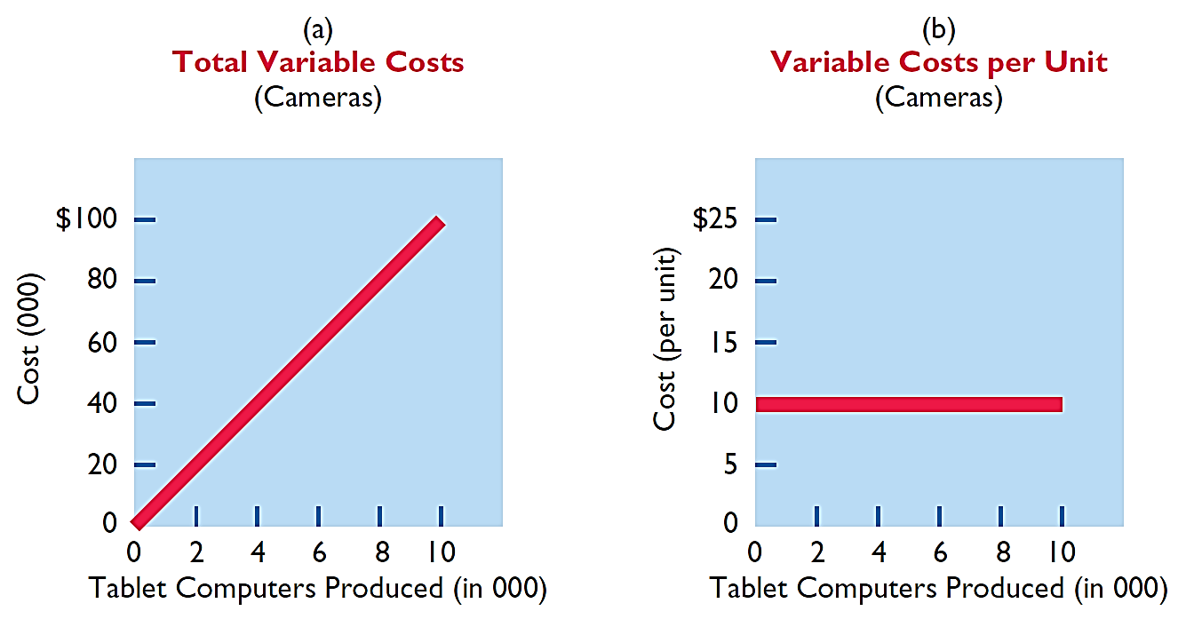
Variable Costs
Illustration: Damon Company manufactures tablet computers that contain a $10 camera. The activity index is the number of tablets produced. As Damon manufactures each tablet, the total cost of the cameras used increases by $10.

Slide 7
Fixed Costs
Costs that remain the same in total regardless of changes in the activity level within a relevant range.
Fixed cost per unit cost varies inversely with activity: As volume increases, unit cost declines, and vice versa.
Examples:
Property taxes
Insurance
Rent
Depreciation on buildings and equipment

Slide 8
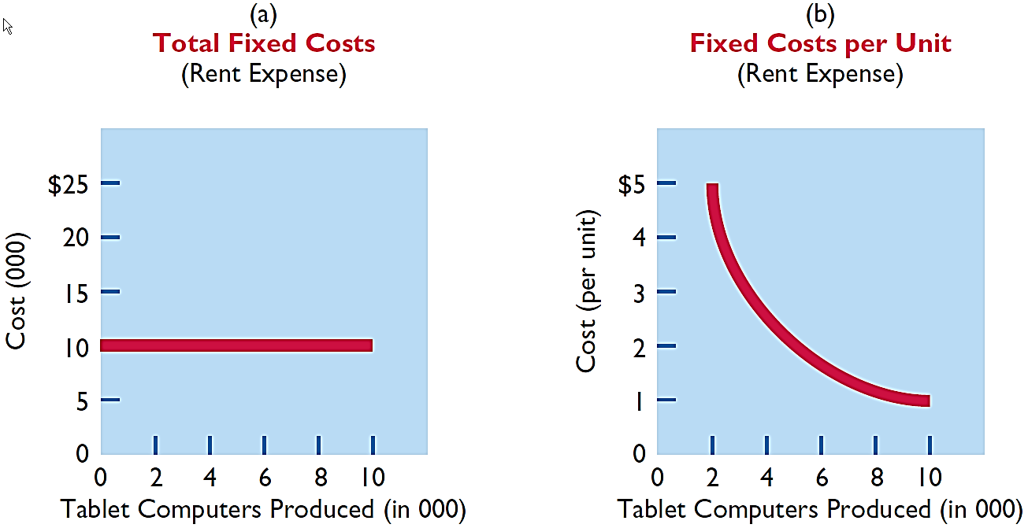
Fixed Costs
Illustration: Damon Company leases its productive facilities at a cost of $10,000 per month.

Slide 9
Relevant Range
Throughout the range of possible levels of activity, a straight-line relationship usually does not exist for either variable costs or fixed costs.
Relationship between variable costs and changes in activity level is often curvilinear.
For fixed costs, the relationship is also nonlinear – some fixed costs will not change over the entire range of activities, while other fixed costs may change.

Slide 10
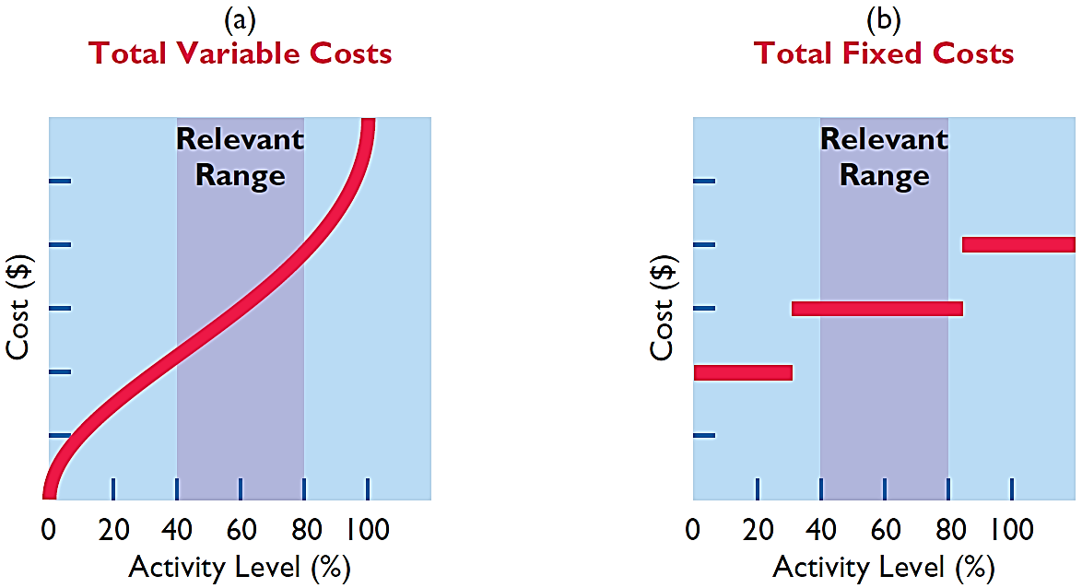
Relevant Range
Useful for CVP analysis
Range of activity over which a company expects to operate during a year.
Within the relevant range, a linear relationship generally exists for both variable and fixed costs.

Slide 11
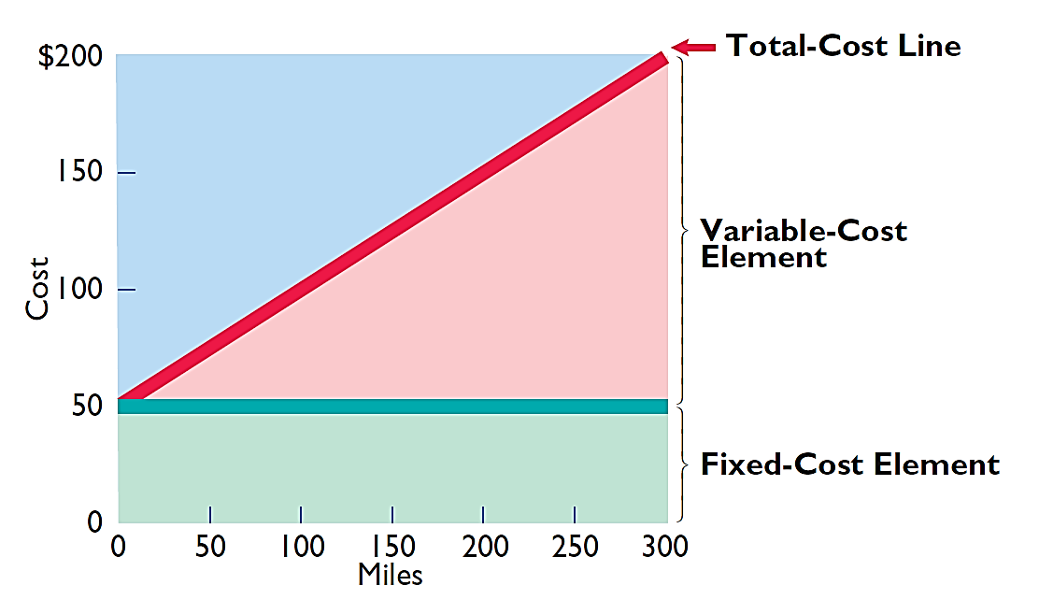
Mixed Costs
Costs that have both a variable element and a fixed element.
Change in total but not proportionately with changes in activity level.

Slide 12

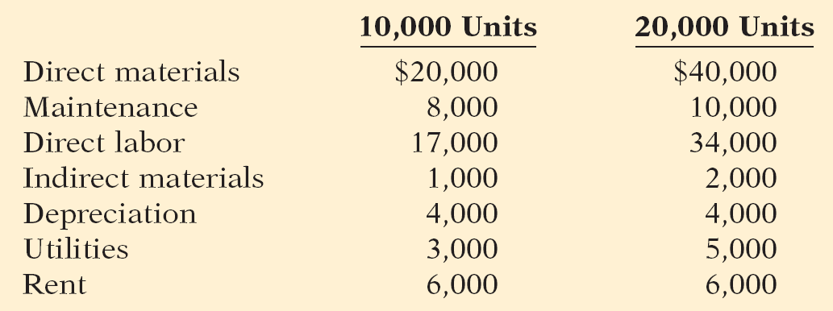
Types of Costs
Helena Company, reports the following total costs at two levels of production.
Classify each cost as variable, fixed, or mixed.
Variable
Fixed
Mixed

Slide 13
Relevant Range
Question
The relevant range is:
The range of activity in which variable costs will be curvilinear.
The range of activity in which fixed costs will be curvilinear.
The range over which the company expects to operate during a year.
Usually from zero to 100% of operating capacity.

Slide 14
Learning Objective 18-2
Mixed Costs Analysis

Slide 15
Outline
High-low method

Slide 16
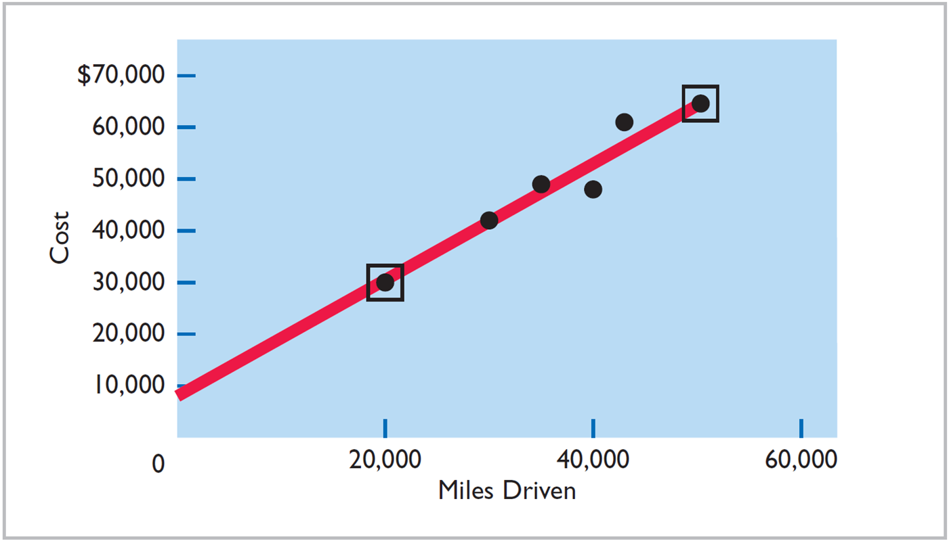
High-Low Method

Slide 17
High-Low Method
High-Low Method uses the total costs incurred at the high and the low levels of activity to classify mixed costs into fixed and variable components.
The difference in costs between the high and low levels represents variable costs, since only variable-cost element can change as activity levels change.

Slide 18
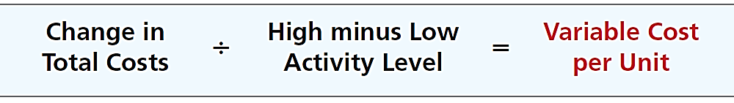
High-Low Method
STEP 1: Determine variable cost per unit using the following formula:

Slide 19
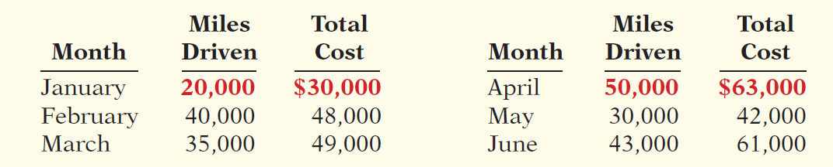
High-Low Method
Illustration: Metro Transit Company has the following maintenance costs and mileage data for its fleet of buses over a 6-month period.
Low
High
Change in Costs
(63,000 - 30,000) $33,000
=
$1.10
High minus Low
(50,000 - 20,000) 30,000
cost per unit

Slide 20
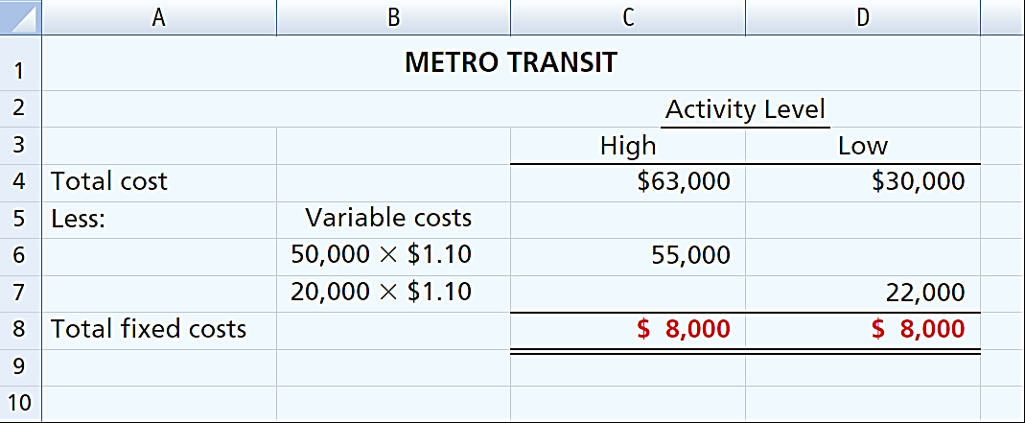
High-Low Method
STEP 2: Determine the fixed cost by subtracting the total variable cost at either the high or the low activity level from the total cost at that activity level.

Slide 21
High-Low Method
Maintenance costs are therefore $8,000 per month of fixed costs plus $1.10 per mile of variable costs. This is represented by the following formula:
Maintenance costs = $8,000 + ($1.10 x Miles driven)
Example: At 45,000 miles, estimated maintenance costs would be:
Fixed
$ 8,000
Variable
($1.10 x 45,000) 49,500
$57,500

Slide 22
High-Low Method

Slide 23
Learning Objective 18-3
Cost-volume-profit (CVP) analysis

Slide 24
Outline
CVP basic components
CVP assumptions
CVP income statement
Unit contribution margin
Contribution margin ratio

Slide 25
Cost-Volume-Profit Analysis
Cost-volume-profit (CVP) analysis is the study of the effects of changes in costs and volume on a company’s profits.
Important in profit planning.
Critical factor in management decisions as
Setting selling prices,
Determining product mix, and
Maximizing use of production facilities.

Slide 26

CVP Basic Components

Slide 27
CVP Assumptions
Behavior of both costs and revenues is linear throughout the relevant range of the activity index.
Costs can be classified accurately as either variable or fixed.
Changes in activity are the only factors that affect costs.
All units produced are sold.
When more than one type of product is sold, the sales mix will remain constant.

Slide 28
CVP Income Statement
A statement for internal use.
Classifies costs and expenses as fixed or variable.
Reports contribution margin in the body of the statement.
Contribution margin – amount of revenue remaining after deducting variable costs.
Contribution margin is available to cover fixed costs and to contribute to income.
Reports the same net income as a traditional income statement.

Slide 29
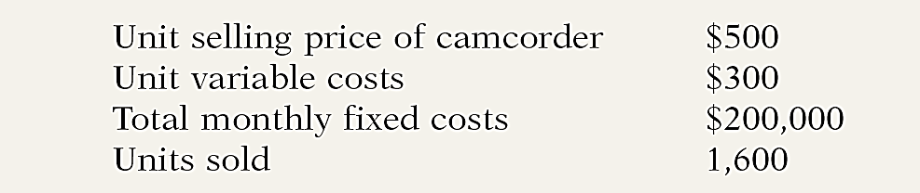
CVP Income Statement
Illustration: Vargo Video Company produces a high-definition digital camcorder. Relevant data for the camcorders sold by this company in June 2014 are as follows.
All basic components except for sales mix (we assume this company only sells one product).

Slide 30
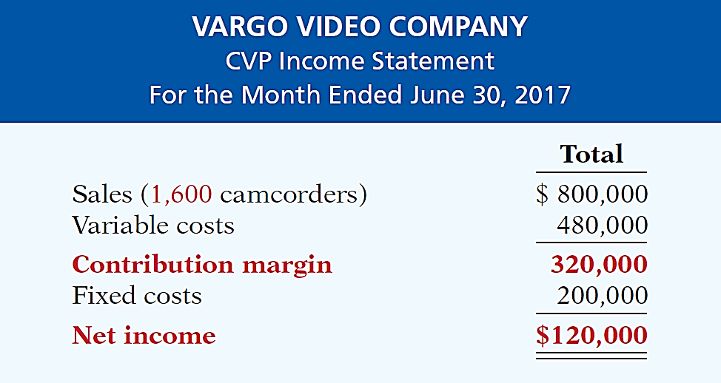
CVP Income Statement
Illustration: The CVP income statement for Vargo Video therefore would be reported as follows.

Slide 31
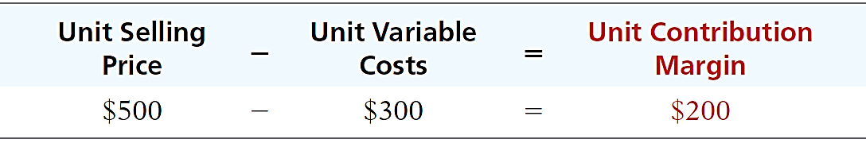
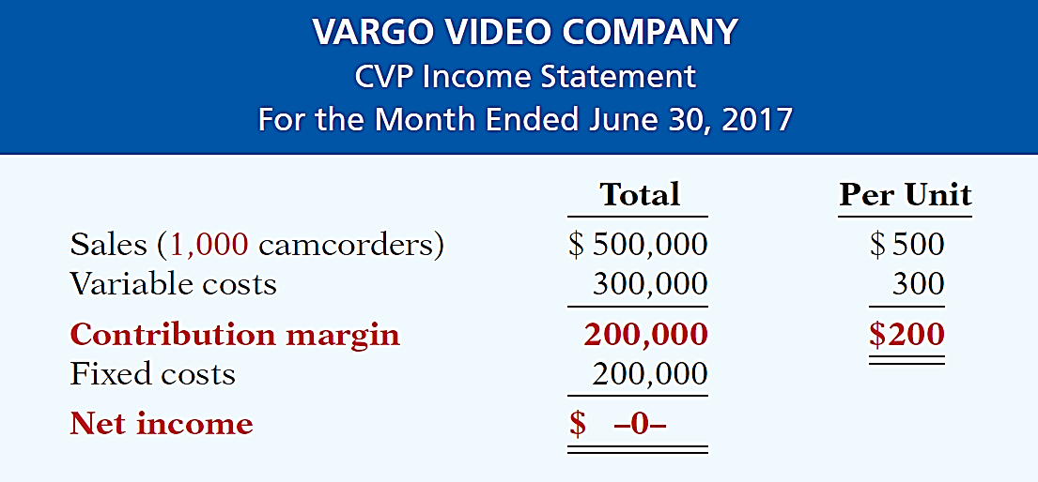
Unit Contribution Margin
Formula for contribution margin per unit and the computation for Vargo Video are:
Breakeven point
Vargo must sell 1,000 units to exactly cover its fixed costs.
=

Slide 32
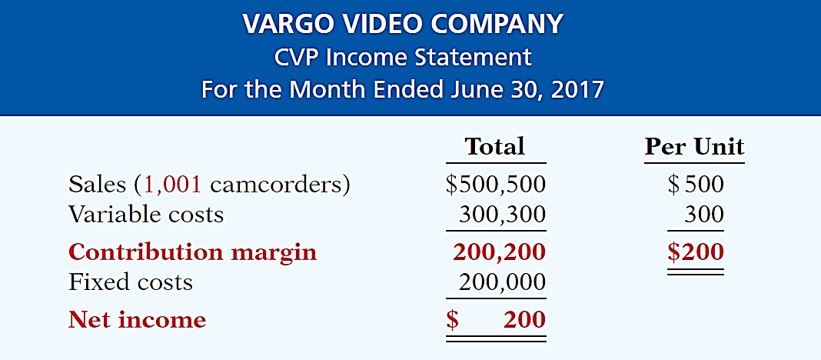
Unit Contribution Margin
Assume that Vargo sold one more camcorder, for a total of 1,001 camcorders sold.
For every unit sold above the BP, net income increases by the amount of the unit contribution margin.

Slide 33
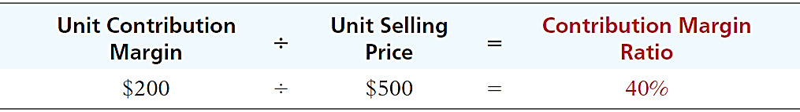
Contribution Margin Ratio
Shows the percentage of each sales dollar available to apply toward fixed costs and profits.
Formula for contribution margin ratio and the computation for Vargo Video are:
This ratio is useful in determining the effect of changes in sales on net income.

Slide 34
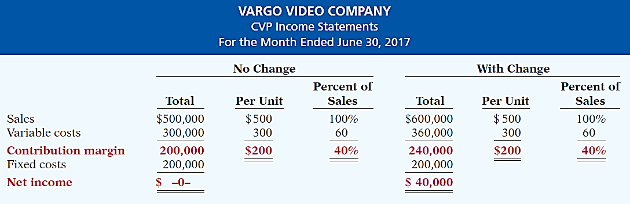
Contribution Margin Ratio
Assume Vargo Video’s current sales are $500,000 (1,000 units) and it wants to know the effect of a $100,000 (200-unit) increase in sales.

Slide 35
CVP Income Statement
Ampco Industries produces and sells a cell phone-operated thermostat. Information regarding the costs and sales of thermostats during September 2017 are provided below.
Unit selling price of thermostat $85
Unit variable costs $32
Total monthly fixed costs $190,000
Units sold 4,000
Prepare a CVP income statement for Ampco Industries for the month of September. Provide per unit values and total values.

Slide 36
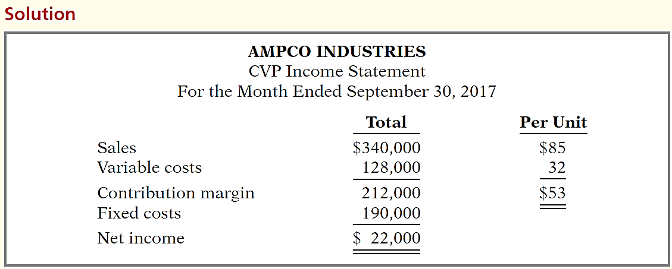
CVP Income Statement
Unit selling price of thermostat $85
Unit variable costs $32
Total monthly fixed costs $190,000
Units sold 4,000

Slide 37
Learning Objective 18-4
Break-Even Analysis

Slide 38
Outline
Break-even analysis
Mathematical equation
Contribution margin technique
Cost-volume-profit (CVP) graph

Slide 39
Break-even Analysis
Process of finding the break-even point – level of activity at which total revenues equal total costs (both fixed and variable).
Can be computed or derived
From a mathematical equation.
By using contribution margin.
From a cost-volume profit (CVP) graph.
Expressed either in sales units or in sales dollars.

Slide 40
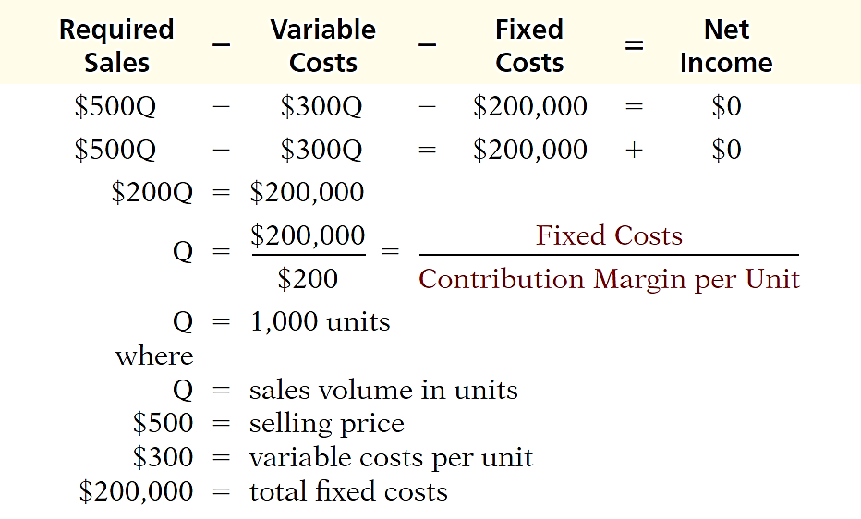
Mathematical Equation
Break-even occurs where total sales equal variable costs plus fixed costs (i.e. net income is zero)
BE Unit sales
BE Dollar sales:
1,000 x $500
or
$500,000

Slide 41
Contribution Margin Technique
At the break-even point, contribution margin must equal total fixed costs
Contribution margin = total revenues – variable costs
Break-even point can be computed using either contribution margin per unit or contribution margin ratio.

Slide 42
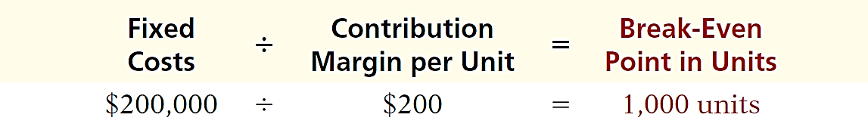
Contribution Margin Technique
CONTRIBUTION MARGIN IN UNITS
When the break-even-point in units is desired, contribution margin per unit is used in the following formula which shows the computation for Vargo Video:
Unit selling price – Unit variable costs

Slide 43
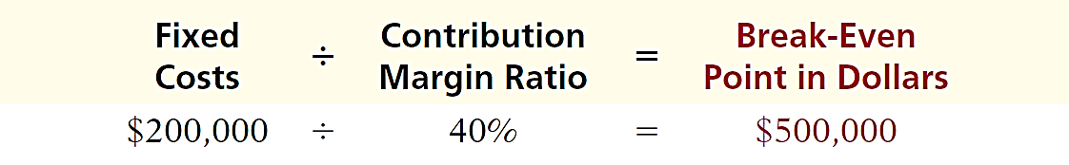
Contribution Margin Technique
CONTRIBUTION MARGIN RATIO
When the break-even-point in dollars is desired, contribution margin ratio is used in the following formula which shows the computation for Vargo Video:
Unit contribution margin / Unit selling price

Slide 44
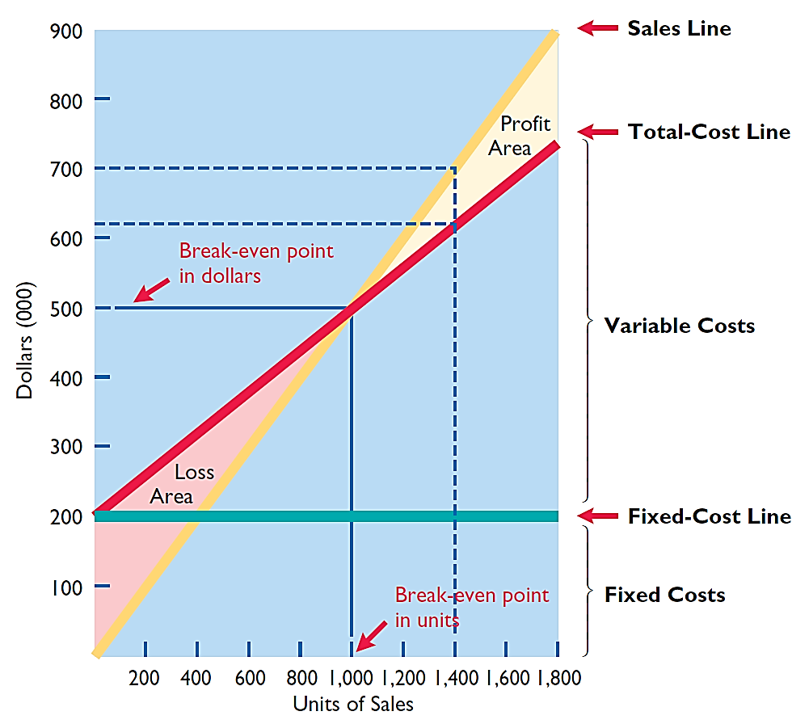
Cost-Volume-Profit (CVP) Graph

Slide 45
Break-Even Analysis
Lombardi Company has a unit selling price of $400, variable costs per unit of $240, and fixed costs of $180,000. Compute the break-even point in units using (a) a mathematical equation and (b) contribution margin per unit.
Variable Costs
Fixed Costs
Net Income
Sales
-
-
=
$400Q
-
$240Q
-
$180,000
=
0
Q
=
1,125 units

Slide 46
Break-Even Analysis
Lombardi Company has a unit selling price of $400, variable costs per unit of $240, and fixed costs of $180,000. Compute the break-even point in units using (a) a mathematical equation and (b) contribution margin per unit.
Fixed Costs
Contribution Margin per Unit
Break-Even Point in Units
÷
=
$180,000
÷
$160
=
1,125 units

Slide 47
Break-Even Analysis
Question
Gossen Company is planning to sell 200,000 pliers for $4 per unit. The contribution margin ratio is 25%. If Gossen will break even at this level of sales, what are the fixed costs?
$100,000.
$160,000.
$200,000.
$300,000.

Slide 48
Learning Objective 18-5
Target Net Income & Margin of Safety

Slide 49
Outline
Target net income
Mathematical equation
Contribution margin technique
Cost-volume-profit (CVP) graph
Margin of safety

Slide 50
Target Net Income
Level of sales necessary to achieve a specified income.
Can be determined from each of the approaches used to determine break-even sales/units:
From a mathematical equation.
By using contribution margin technique.
From a cost-volume profit (CVP) graph.
Expressed either in sales units or in sales dollars.

Slide 51
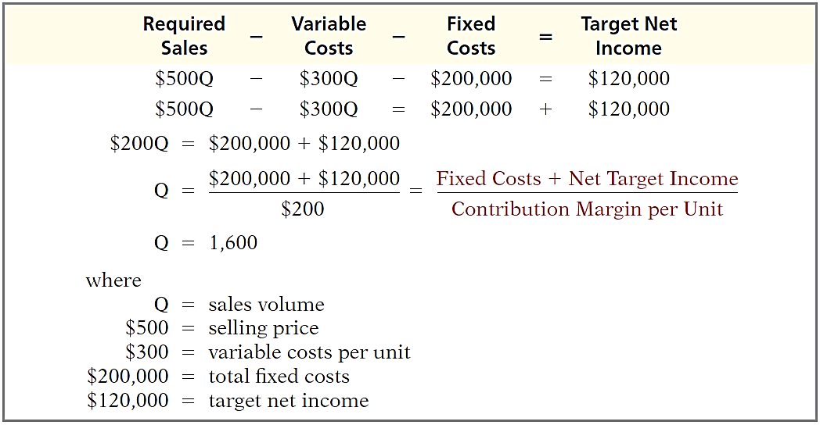
Mathematical Equation
Using the formula for the break-even point, simply include the desired net income as a factor (e.g. $120,000)
Required Unit sales
Required Dollar sales:
1,600 x $500
or
$800,000

Slide 52
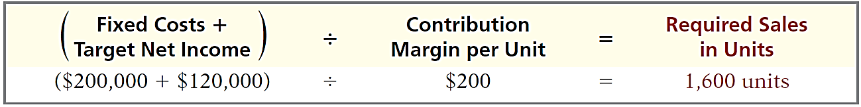
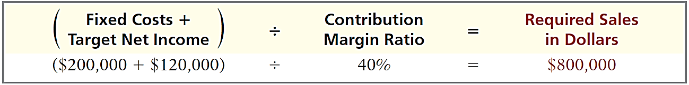
Contribution Margin Technique
To determine the required sales in units for Vargo Video:
Unit selling price – Unit variable costs
To determine the required sales in dollars for Vargo Video:
Unit contribution margin / Unit selling price

Slide 53
Cost-Volume-Profit (CVP) Graph
$120,000

Slide 54
Margin of Safety
Difference between actual or expected sales and sales at the break-even point.
Measures the “cushion” that a particular level of sales provides.
May be expressed in dollars or as a ratio.

Slide 55
Margin of Safety
Assuming actual/expected sales are $750,000 and break-even sales of $500,000.
Margin of safety in dollars:
Actual (expected) sales – Break-even sales
$750,000 – $500,000 = $250,000
Margin of safety ratio:
Margin of safety in dollars / Actual (expected) sales
$250,000 / 750,000 = 33%
The higher the dollars or percentage, the greater the margin of safety.

Slide 56
Margin of Safety
Question
Marshall Company had actual sales of $600,000 when break-even sales were $420,000. What is the margin of safety ratio?
25%.
30%.
33 1/3%.
45%.

Slide 57
Learning Objective 19-2
Sales Mix and Break-Even Sales

Slide 58
Outline
Sales mix
Break-even sales in units
Break-even sales in dollars

Slide 59
Sales Mix
Sales mix is the relative percentage in which a company sells its products.
If a company’s unit sales are 80% printers and 20% computers, its sales mix is 80% to 20%.
Sales mix is important because different products often have very different contribution margins.

Slide 60
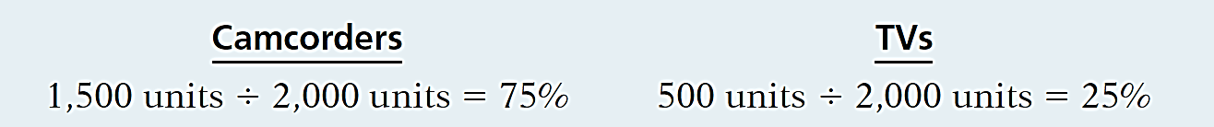
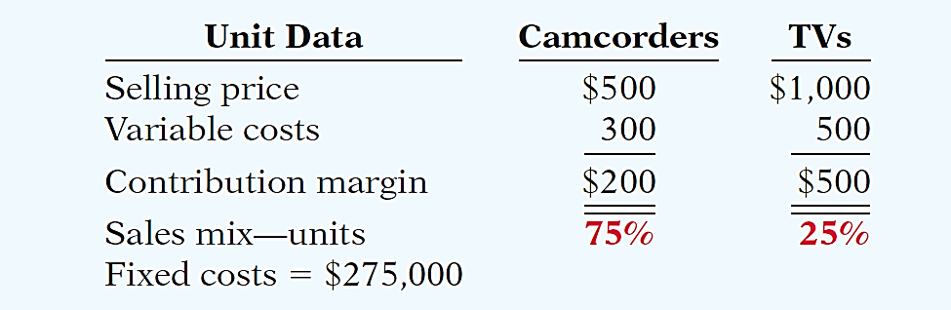
Break-Even Sales in Units
Companies can compute break-even sales for a mix of two or more products by determining the weighted-average unit contribution margin of all the products.
Vargo sells its two products in the following amounts: 1,500 camcorders and 500 TVs.

Slide 61
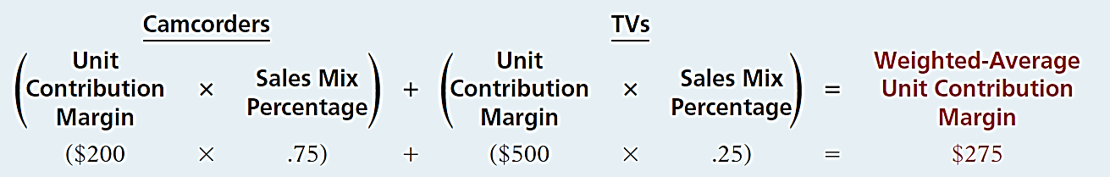
Break-Even Sales in Units
First, determine the weighted-average contribution margin.

Slide 62
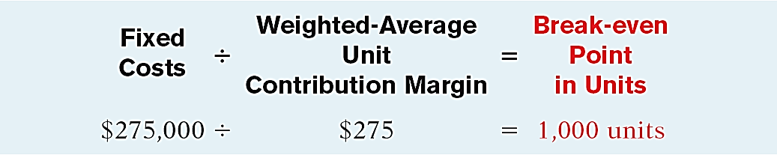
Break-Even Sales in Units
Second, use the weighted-average unit contribution margin to compute the break-even point in units

Slide 63
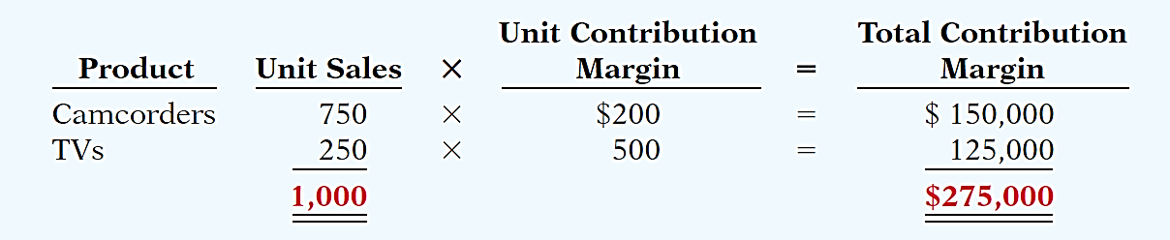
Break-Even Sales in Units
With a break-even point of 1,000 units, Vargo must sell:
750 Camcorders (1,000 units x 75%)
250 TVs (1,000 units x 25%)
At this level, the total contribution margin will equal the fixed costs of $275,000.

Slide 64
Break-Even Sales in Dollars
Works well if the company has many products.
Calculates break-even point in terms of sales dollars for
divisions or
product lines,
NOT individual products.
Here, we compute the sales mix as a percentage of total dollar sales and the contribution margin ratio.

Slide 65
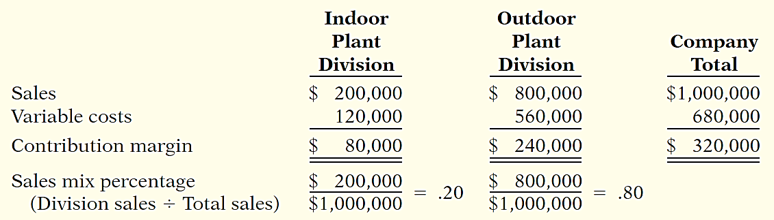
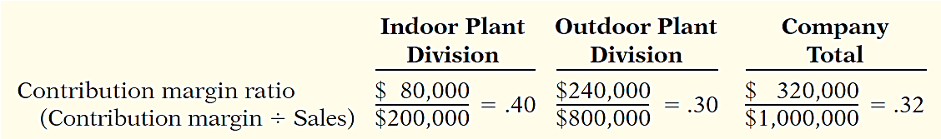
Break-Even Sales in Dollars
Illustration: Kale Garden Supply Company has two divisions.
Weighted average contribution margin ratio

Slide 66
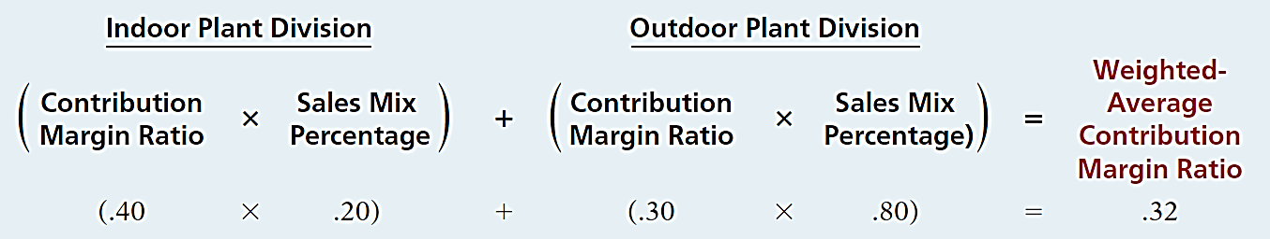
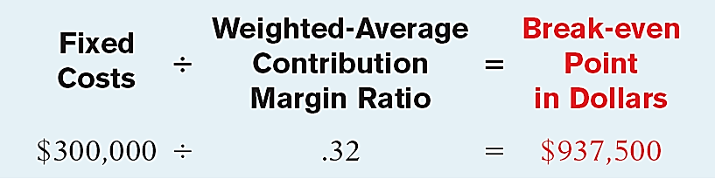
Break-Even Sales in Dollars
First, determine the weighted-average contribution margin.
Second, calculate break-even point in dollars.

Slide 67
Break-Even Sales in Dollars
With break-even sales of $937,500 and a sales mix of 20% to 80%, Kale must sell:
$187,500 from the Indoor Plant division
$750,000 from the Outdoor Plant division
If the sales mix becomes 50% to 50%, the weighted average contribution margin ratio changes to 35%, resulting in a lower break-even point of $857,143.

Slide 68
Break-Even Sales in Dollars
Question
Net income will be:
a. Greater if more higher-contribution margin units are sold than lower-contribution margin units.
b. Greater if more lower-contribution margin units are sold than higher-contribution margin units.
c. Equal as song as total sales remain equal, regardless of which products are sold.
d. Unaffected by changes in the mix of products sold.

Slide 69
Learning Objective 19-3
Sales Mix with Limited Resources

Slide 70
Outline
Limited resources
Contribution margin per unit of limited resource

Slide 71
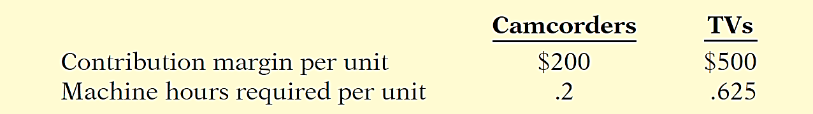
Sales Mix with Limited Resources
All companies have limited resources whether it be floor space, raw materials, direct labor hours, etc.
Management must decide which products to sell to maximize net income.
Illustration: Vargo makes camcorders and TVs. Machine capacity is limited to 3,600 hours per month.

Slide 72
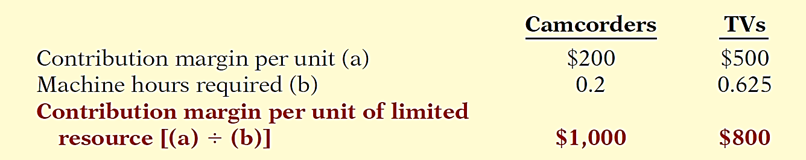
Sales Mix with Limited Resources
Calculate the contribution margin per unit of limited resource.
Management should produce more camcorders if demand exists or else increase machine capacity.

Slide 73
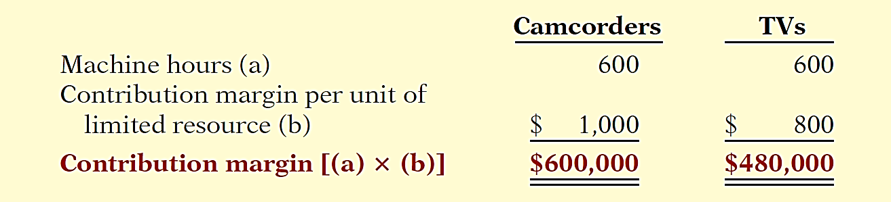
Sales Mix with Limited Resources
If Vargo is able to increase machine capacity from 3,600 hours to 4,200 hours, the additional 600 hours could be used to produce either the camcorders or TVs.
To maximize net income, all 600 hours should be used to produce and sell camcorders.

Slide 74
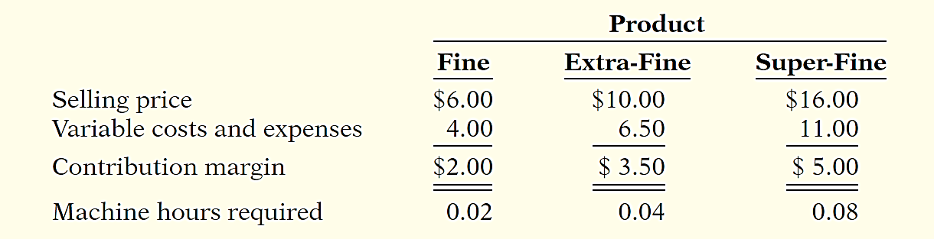
Sales Mix with Limited Resources
Carolina Corporation manufactures and sells three different types of high-quality sealed ball bearings for mountain bike wheels. They are referred to as Fine, Extra-Fine, and Super-Fine bearings. Machine time is limited. More machine time is required to manufacture the Extra-Fine and Super-Fine bearings. Additional information is provided below.

Slide 75
Sales Mix with Limited Resources
Ignoring the machine time constraint, what strategy would appear optimal?
Solution
The Super-Fine bearings have the highest unit contribution margin. Thus, ignoring any manufacturing constraints, it would appear that the company should shift toward production of more Super-Fine units.

Slide 76
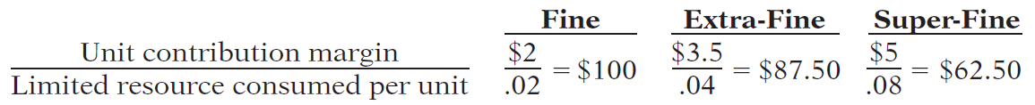
Sales Mix with Limited Resources
What is the contribution margin per unit of limited resource for each type of bearing?
Solution

Slide 77
Sales Mix with Limited Resources
If additional machine time could be obtained, how should the additional capacity be used?
Solution
The Fine bearings have the highest contribution margin per unit of limited resource even though they have the lowest unit contribution margin. Given the resource constraint, any additional capacity should be used to make Fine bearings.

Slide 78
Sales Mix with Limited Resources
Question
If the contribution margin per unit is $15 and it takes 3.0 machine hours to produce the unit, the contribution margin per unit of limited resource is:
a. $25.
b. $5.
c. $4.
d. No correct answer is given.

Slide 79
Learning Objective 19-4
Operating Leverage and Profitability

Slide 80
Outline
Cost structure
Effect on contribution margin ratio
Effect on break-even point
Effect on margin of safety
Operating leverage

Slide 81
Cost Structure
Cost Structure is the relative proportion of fixed versus variable costs that a company incurs.
May have a significant effect on profitability.
Company must carefully choose its cost structure.

Slide 82
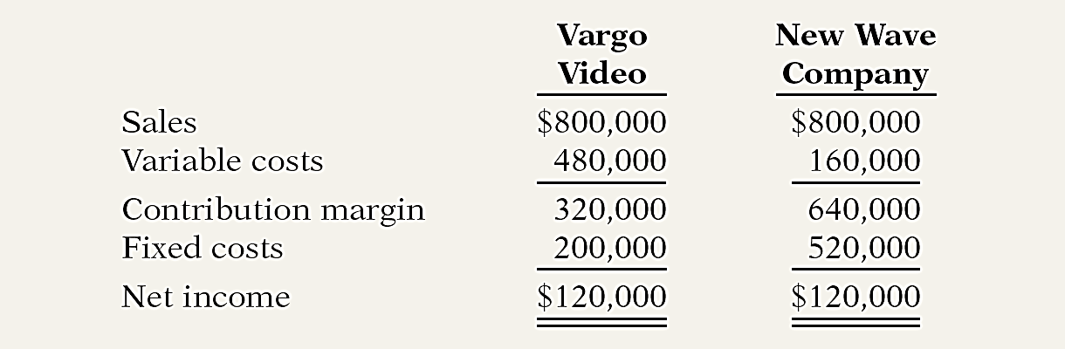
Cost Structure
Illustration: Vargo Video and one of its competitors, New Wave Company, both make camcorders. Vargo Video uses a traditional, labor-intensive manufacturing process. New Wave Company has invested in a completely automated system.
Same sales and same net income but different cost structure.

Slide 83
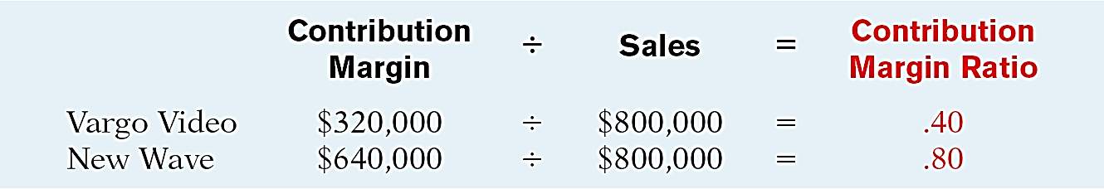
Effect on Contribution Margin Ratio
First, let’s look at the contribution margin ratios.

Slide 84
Effect on Contribution Margin Ratio
New Wave contributes 80 cents to net income for each dollar of increased sales while Vargo only contributes 40 cents.
For every dollar that sales declines, New Wave loses 80 cents in net income, whereas Vargo will only lose 40 cents.
New Wave’s cost structure which relies on fixed costs is more sensitive to changes in sales.

Slide 85
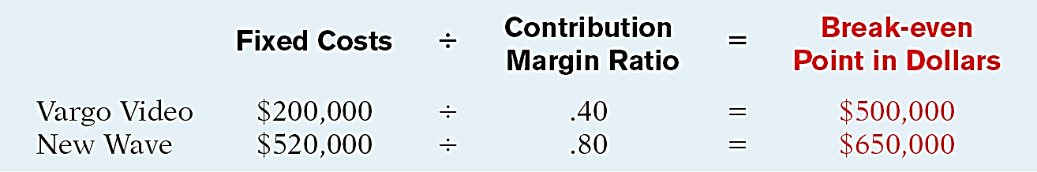
Effect on Break-Even Point
Calculate the break-even point.
New Wave needs to generate $150,000 more in sales than Vargo to break-even.
Because of the greater break-even sales required, New Wave is a riskier company than Vargo.

Slide 86
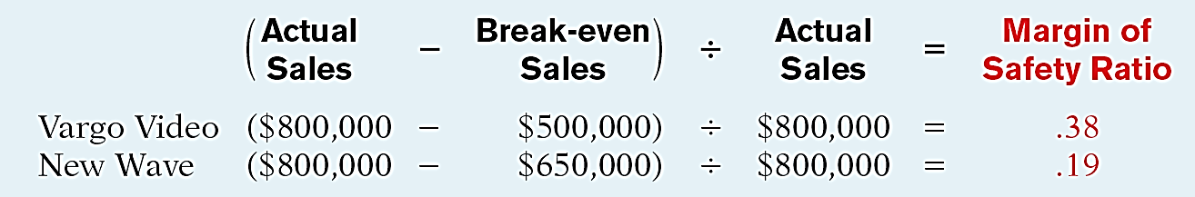
Effect on Margin of Safety
Computation of margin of safety ratio
The difference in ratios reflects the difference in risk between New Wave and Vargo.
Vargo can sustain a 38% decline in sales before operating at a loss versus only a 19% decline for New Wave.

Slide 87
Operating Leverage
Operating leverage refers to the extent that net income reacts to a given change in sales.
Higher fixed costs relative to variable costs cause a company to have higher operating leverage.
When sales revenues are increasing, high operating leverage means that profits will increase rapidly.
When sales revenues are declining, too much operating leverage can have devastating consequences.

Slide 88
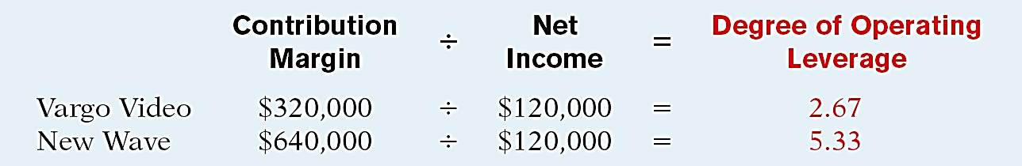
Degree of Operating Leverage
Provides a measure of a company’s earnings volatility.
Computed by dividing total contribution margin by net income.
New Wave’s earnings would go up (or down) by about two times (5.33 / 2.67 = 1.99) as much as Vargo’s with an equal percentage increase in sales.

Slide 89
Operating Leverage
Question
The degree of operating leverage:
a. Can be computed by dividing total contribution margin by net income.
b. Provides a measure of the company’s earnings volatility.
c. Affects a company’s break-even point.
d. All of the above.

